Slide 1
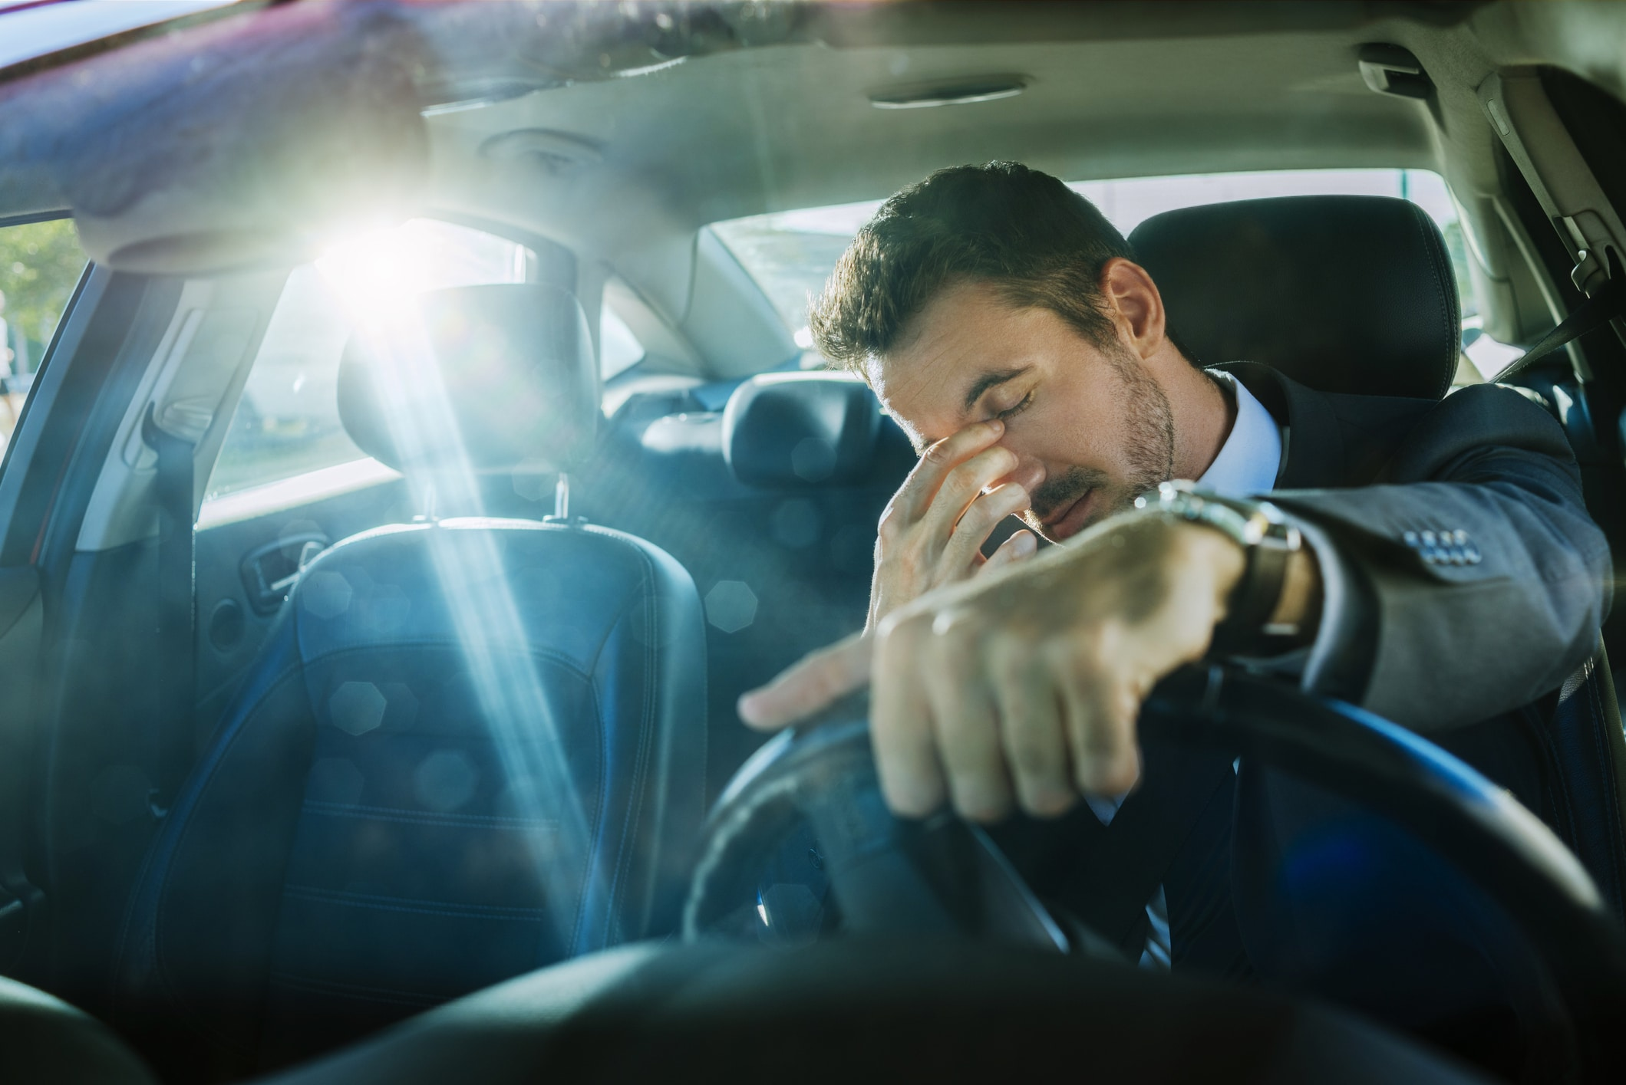
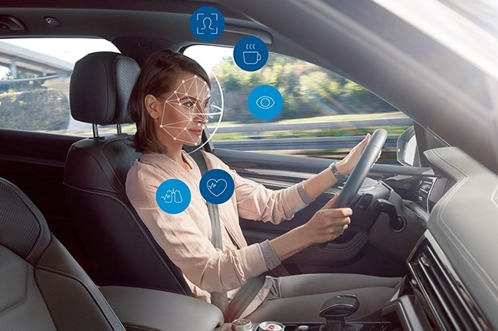

DROWSINESS DETECTION
Advanced Topics in Machine Learning
Greta Piliponyte e Rachel Fanti

Slide 2

The problem
Drowsy Driving is a dangerous behavior that should be stopped.
Statistics in USA:​
​
100,000 police-reported crashes and over 1,500 deaths each year.​
More than 40% of drivers admitted they have fallen asleep behind the wheel.​

Slide 3
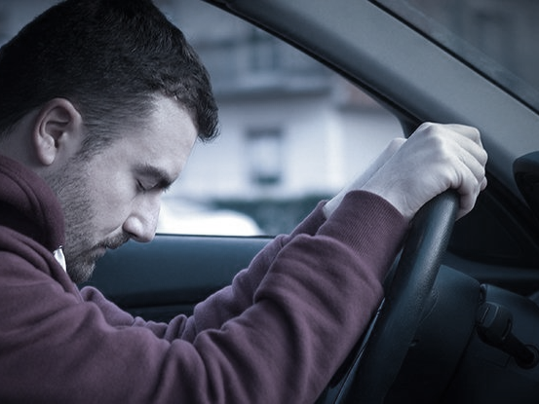
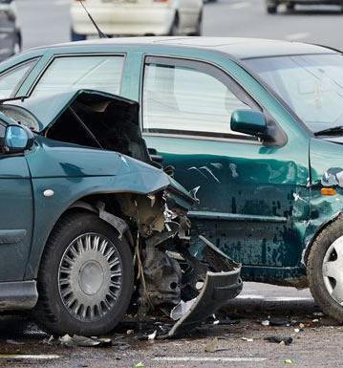

Slide 4

The solution

Slide 5
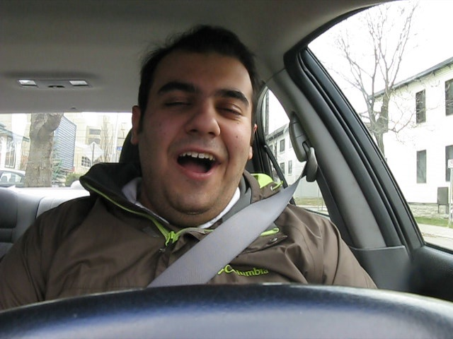
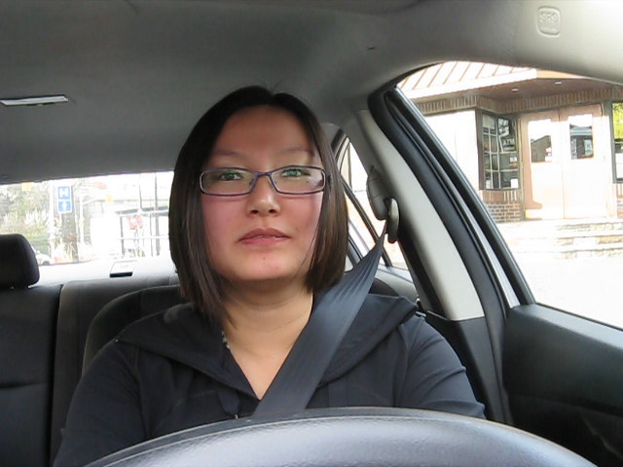
Build a system that can detect drowsiness condition.

Slide 6
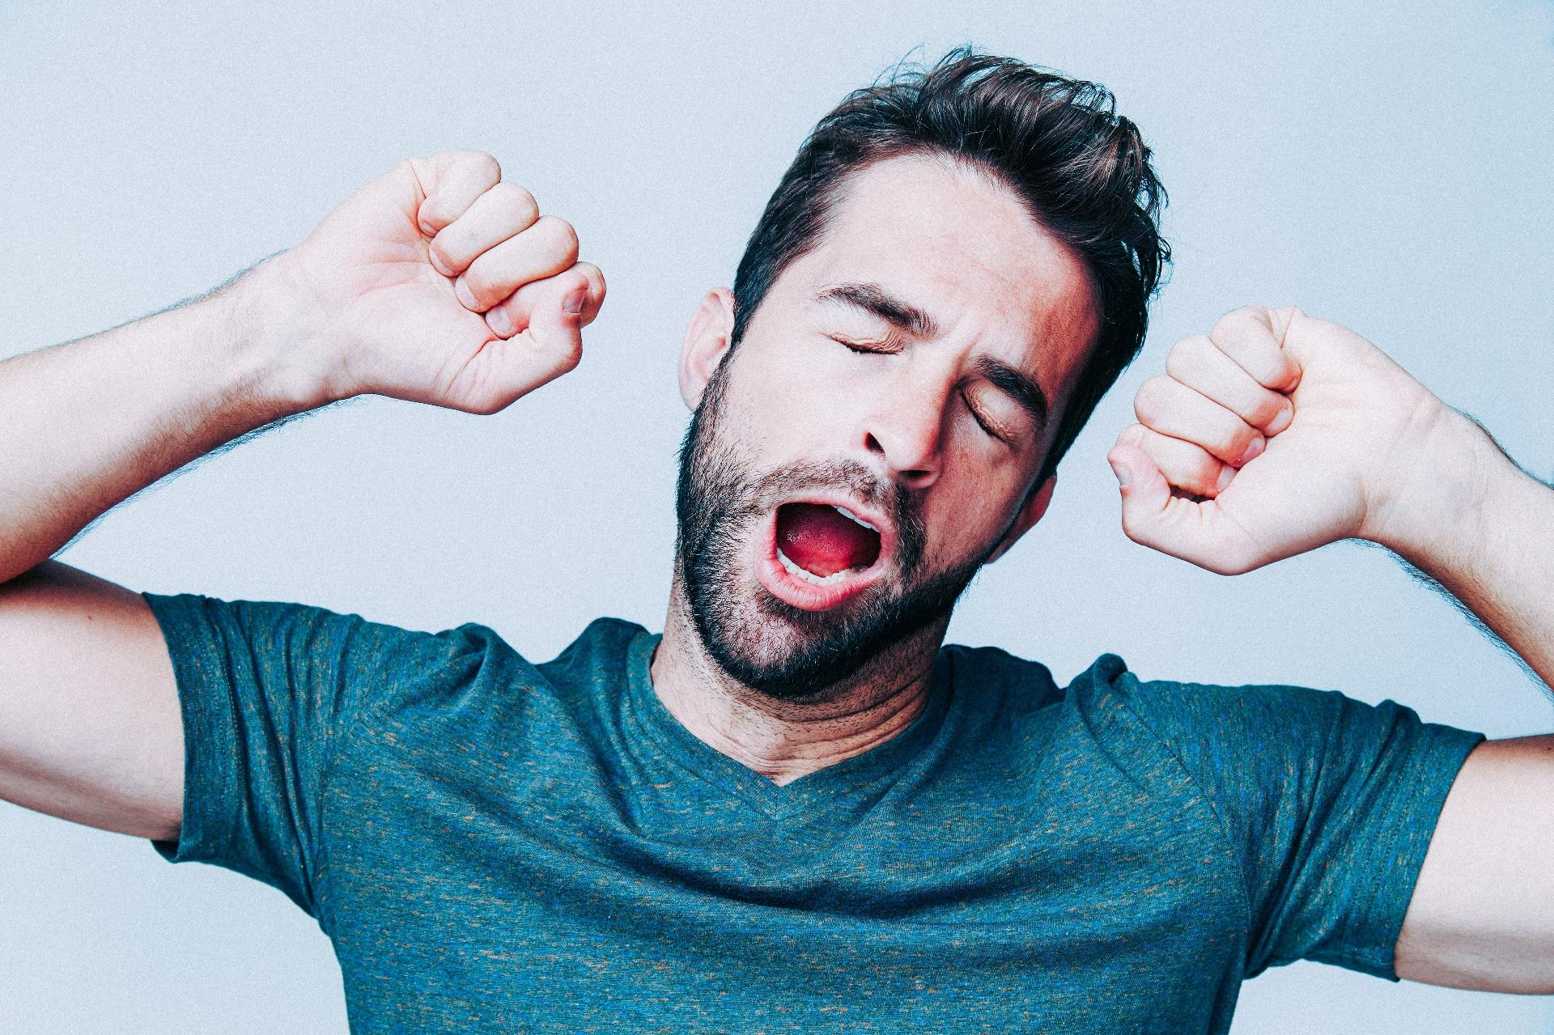
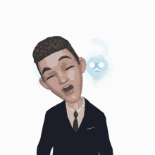
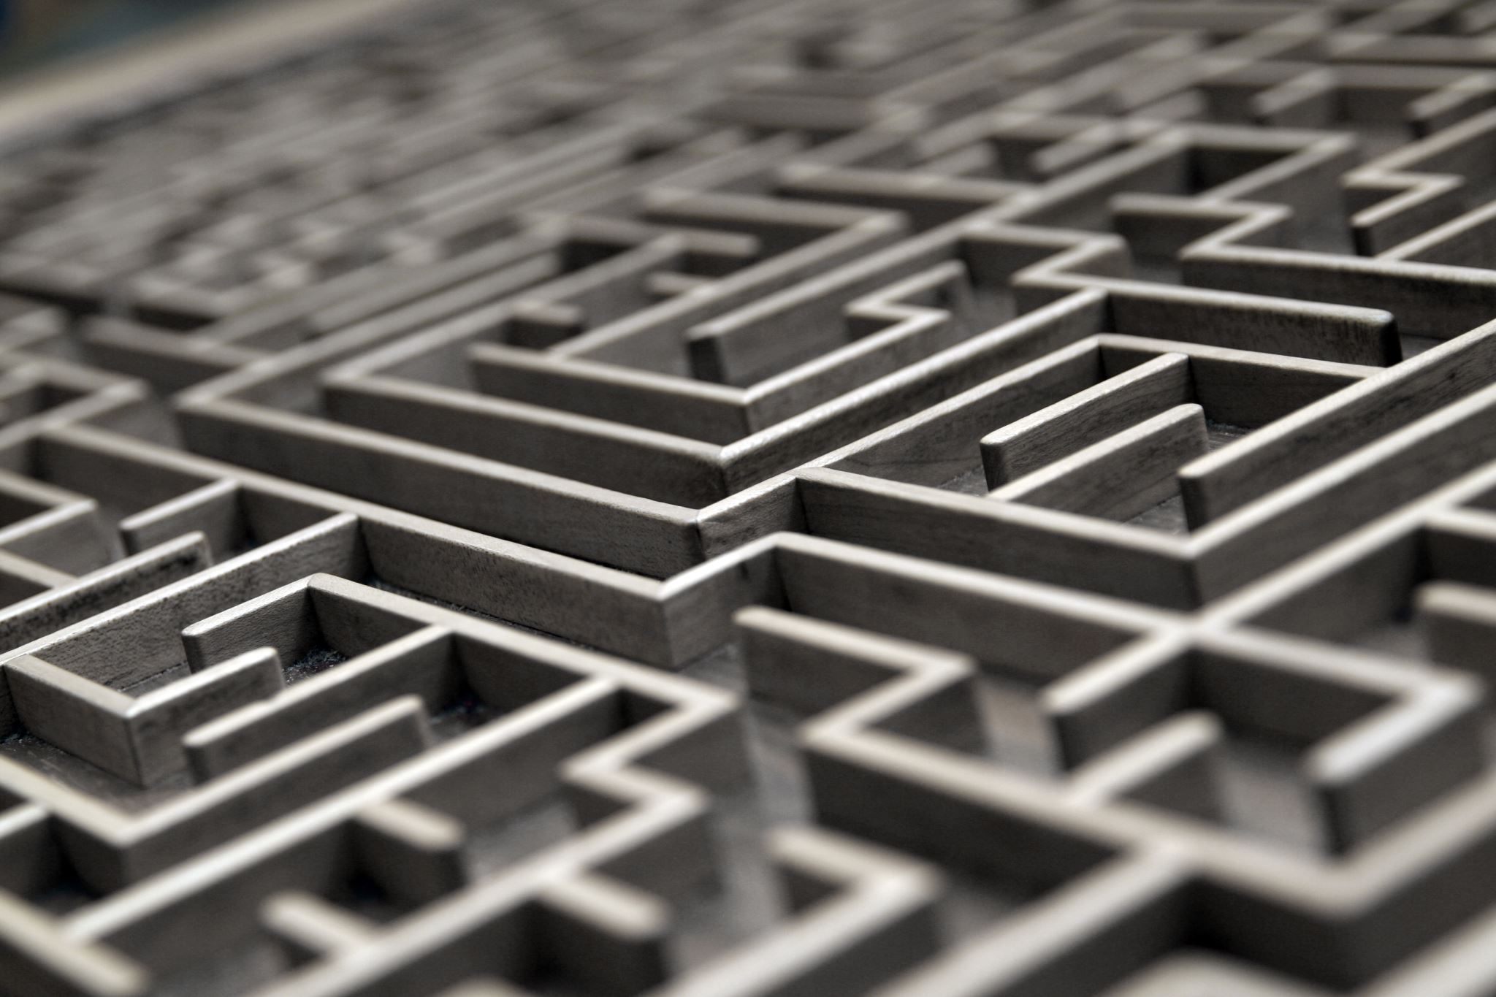
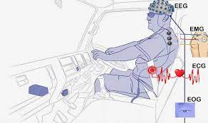
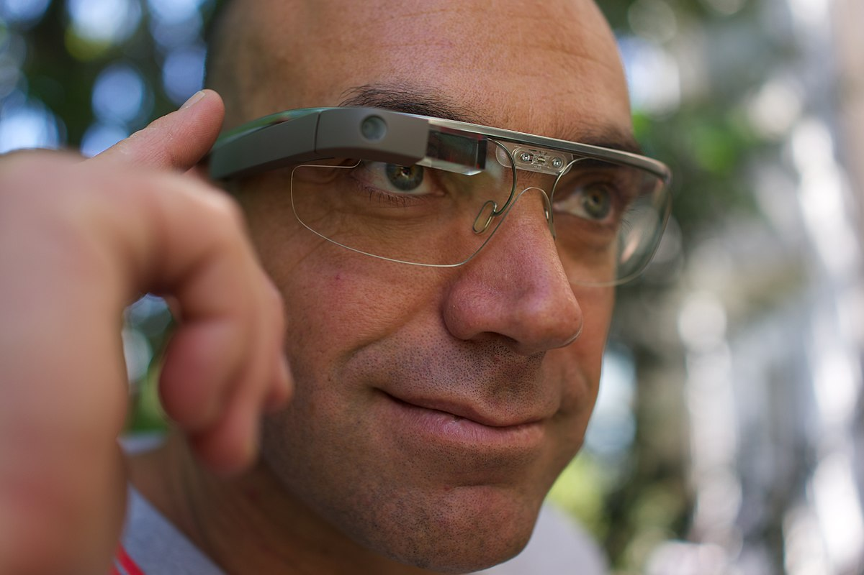
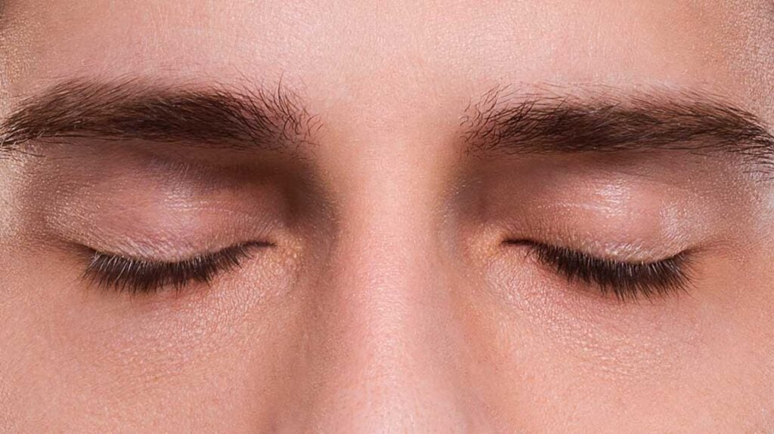
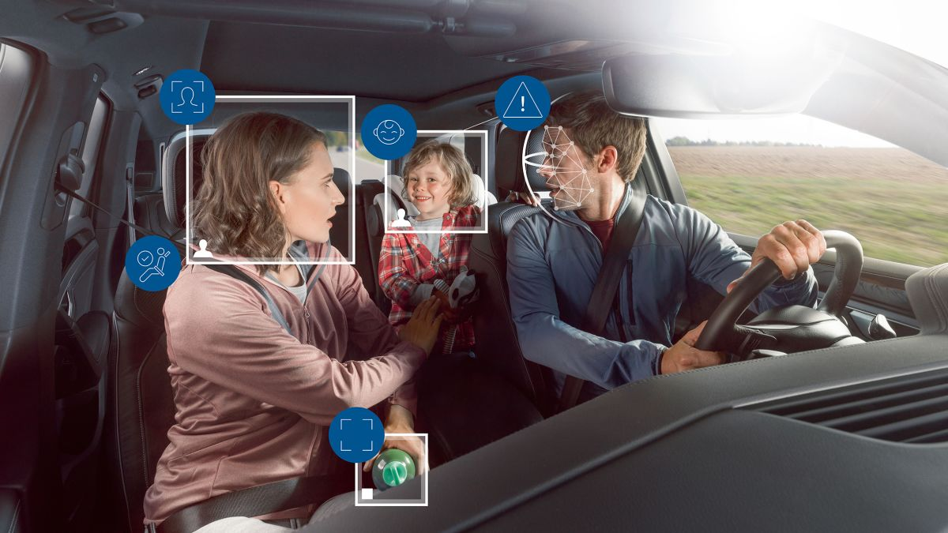
X Varies person to person
X yawn or movements are not necessarily bad
1. Yawning
2. Nodding
X Drivers need to wear or attach to the body
3. Physical sensors
√ Alerts for closed eyes / no detection of eyes
4. Closed eyes
5. Distraction

Slide 7

The dataset

Slide 8
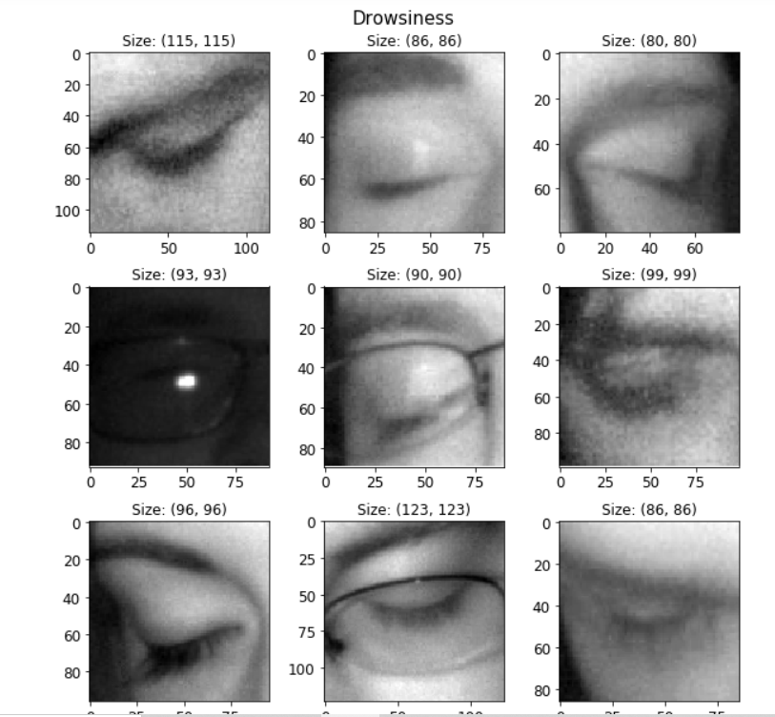
About the Dataset
Drowsiness Detection
Human Eye images, MRL Eye Dataset
https://www.kaggle.com/kutaykutlu/drowsiness-detection
48.000 files - Closed/Opened eyes
PNG
Grey Scale
Different formats (e.g. 86x86 – 123x123)
Notes:
L mode image (just stores the Luminance). - single channel image, normally interpreted as greyscale.

Slide 9

The proposed solution

Slide 10
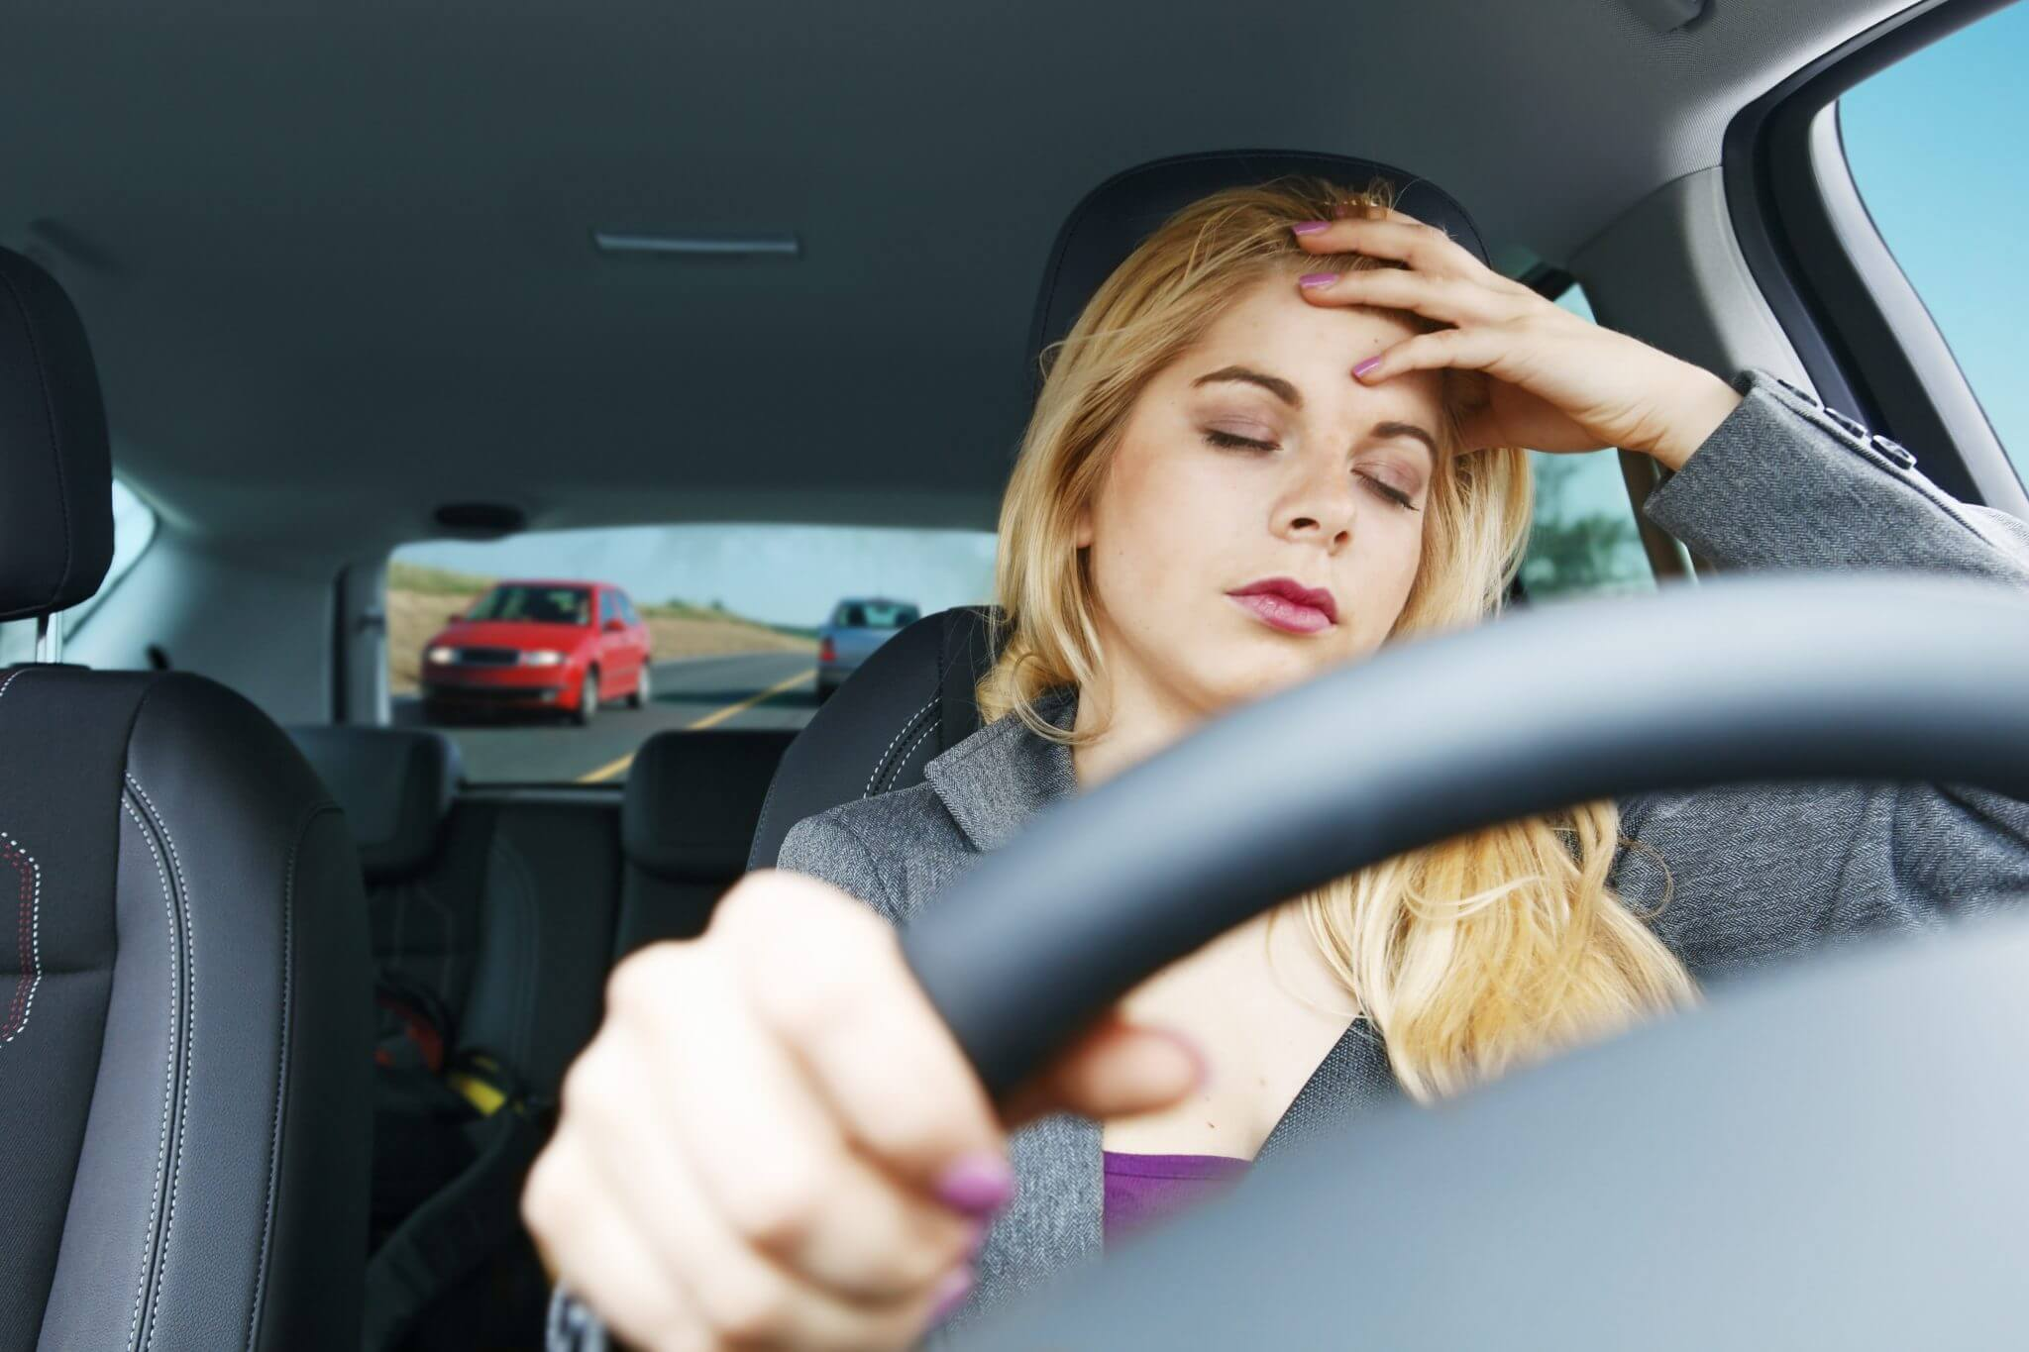
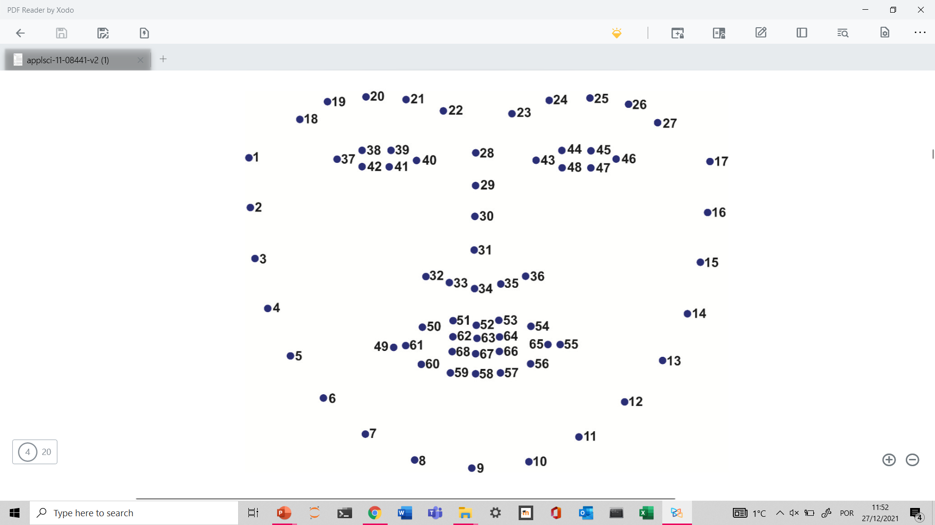
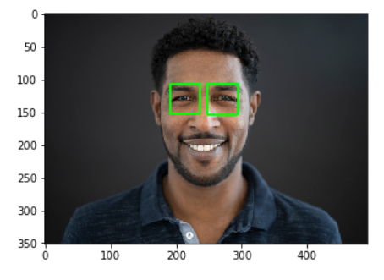
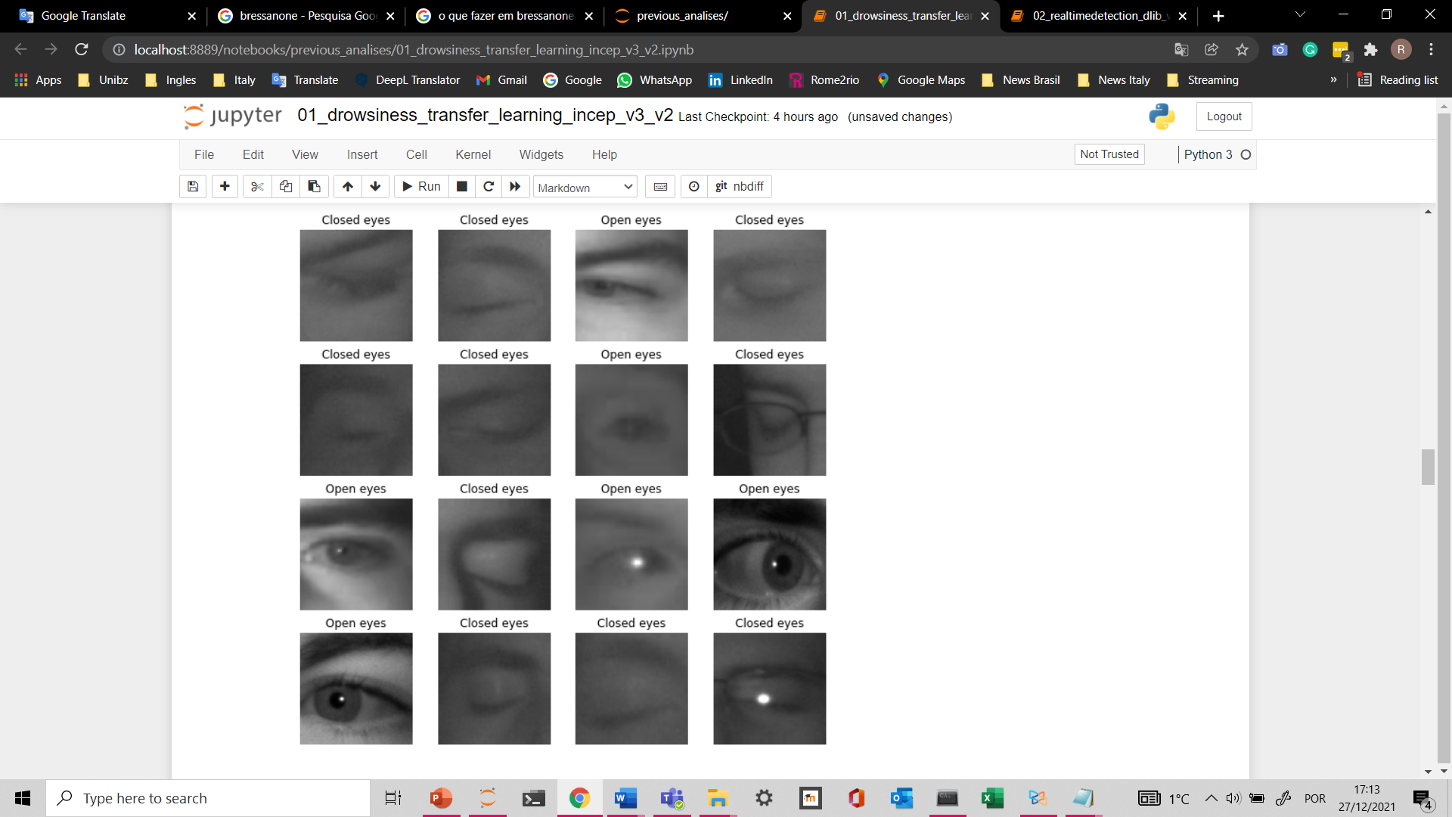
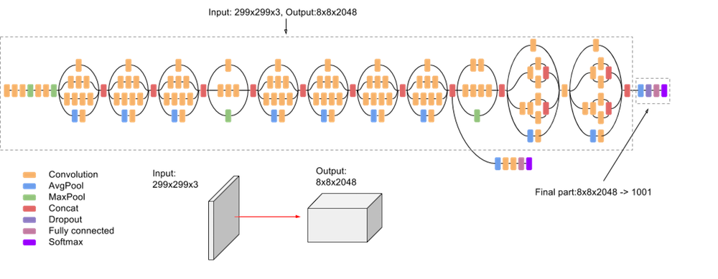

Implementation
Python and Keras
Dlib
OpenCV
Input
Facial detection
Eyes extraction
Pre-processing
Classifi-cation
Results
Recording video camera
--→ Figure
68 Facial landmarks identification
Identify positions of eyes and crop images
Normalize and data augmentation
Using transfer learning models (open/closed eyes)
Camera Alerts
(Time>x)
Drowsiness ALERT!!
BEEP!

Slide 11
Open CV
Capture video and frame
Show face and eyes rectangles
Show screen messages
“Cannot open camera“
"Can't receive frame (stream end?). Exiting ...“
“No face detected”
'Eyes are not detected’
“ALERT!!!!!” (BEEP)

Slide 12
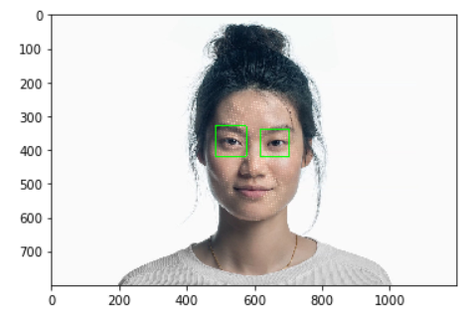
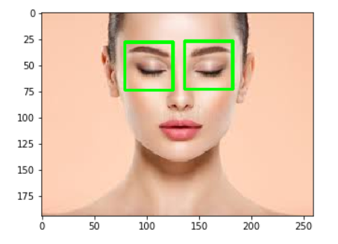
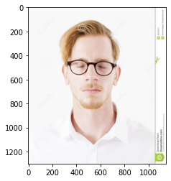
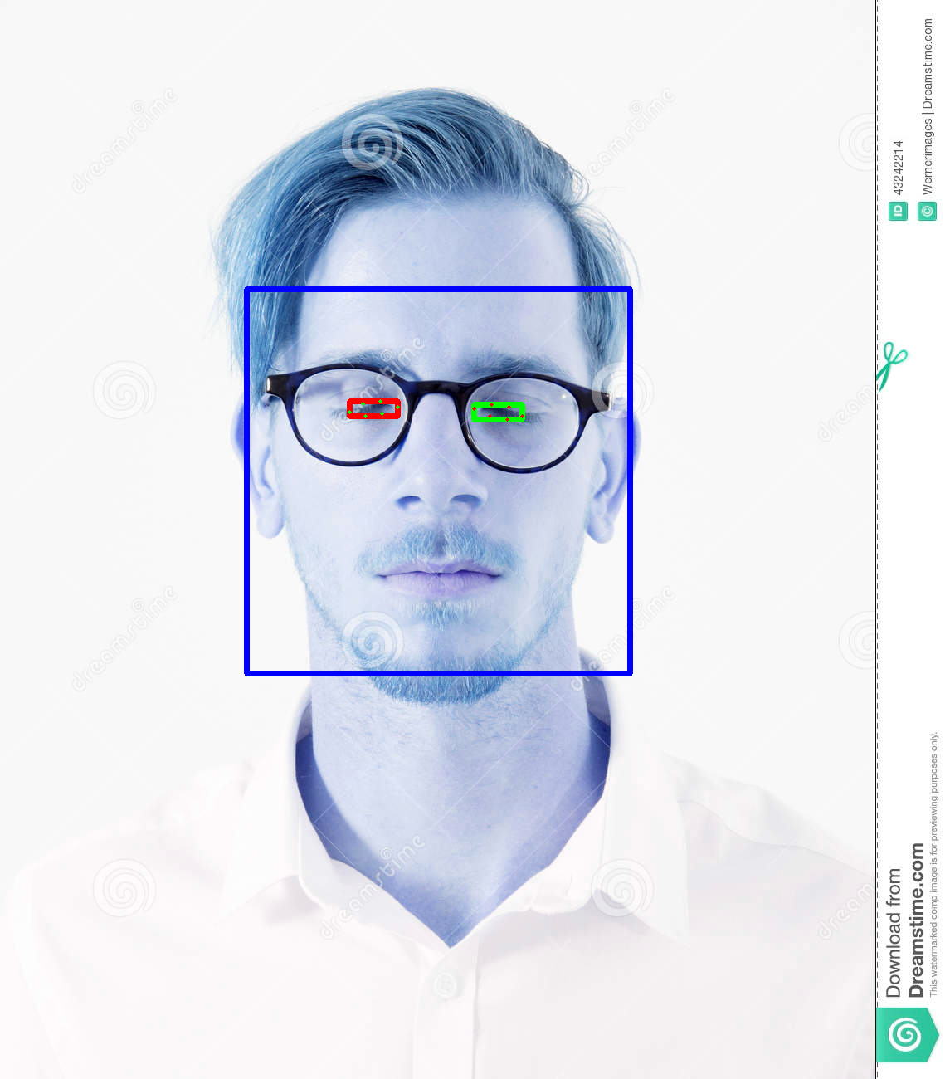
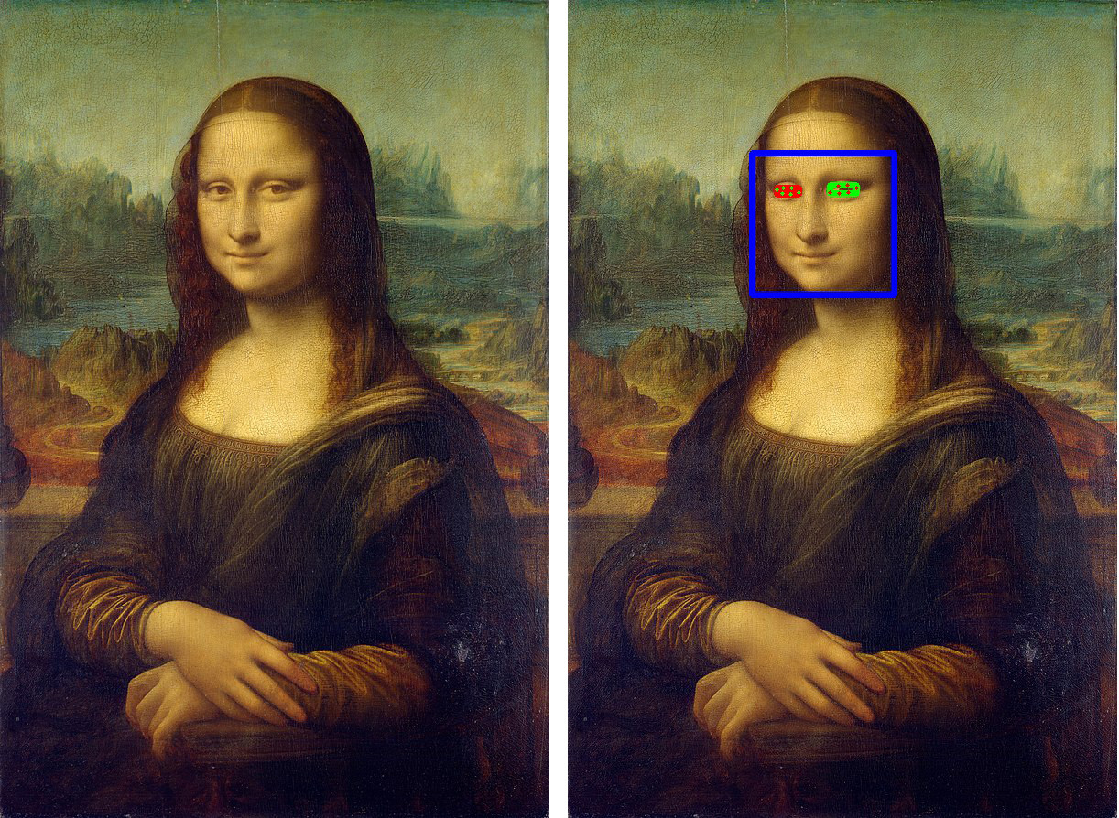
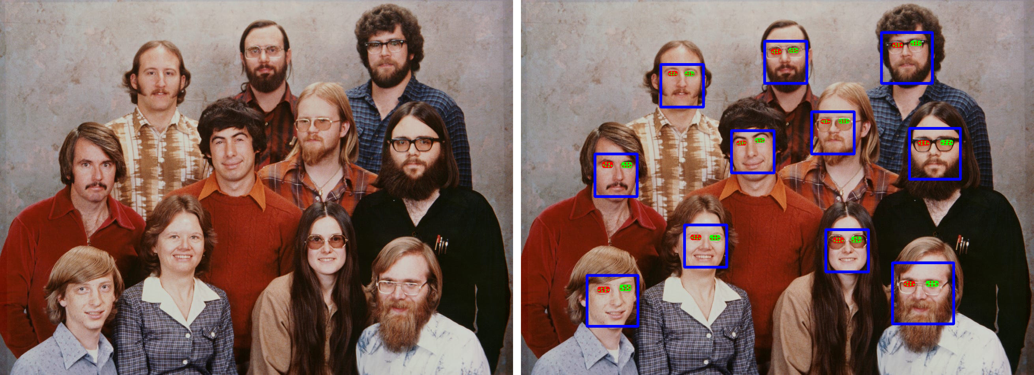
Detection of faces and eyes
Test with pictures

Slide 13

The preprocessing

Slide 14
Pre processing
Pre-process input for each model
incep_v3_preprocess_input
scale input pixels between -1 and 1
Vgg16.preprocess_input
convert the input images from RGB to BGR,
zero-center each color channel with respect to the ImageNet dataset, without scaling
Default shape of each model
inception v3 (299, 299, 3)
VGG 16 (224, 224, 3)
Data augmentation
Train set:
Rotation range = 0.2,
Shear range = 0.2,
Zoom range = 0.2,
Horizontal flip=True

Slide 15
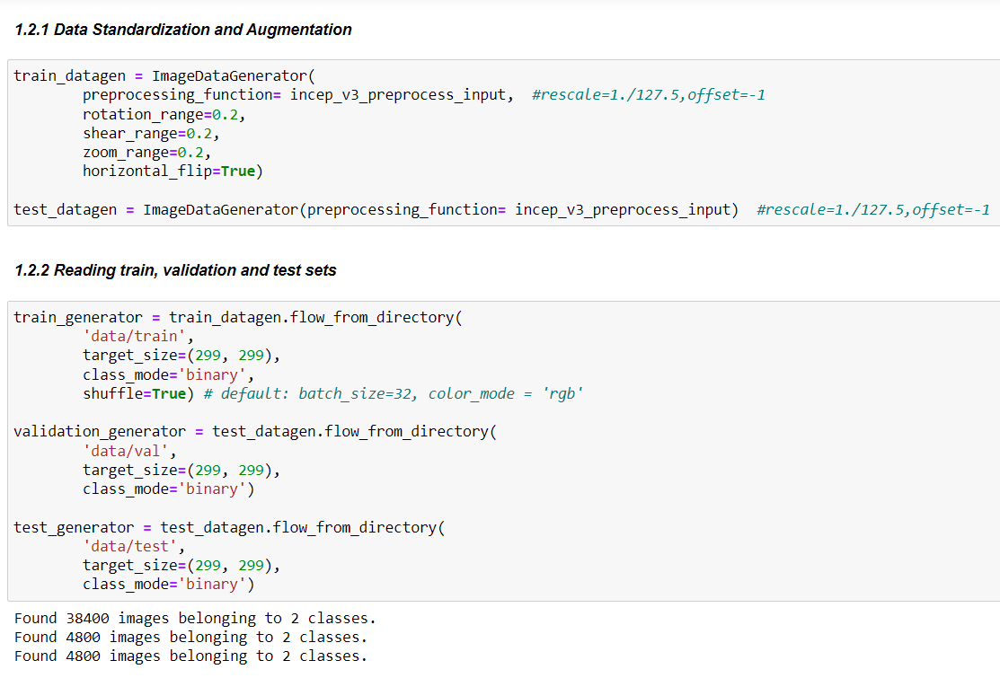
Pre processing

Slide 16
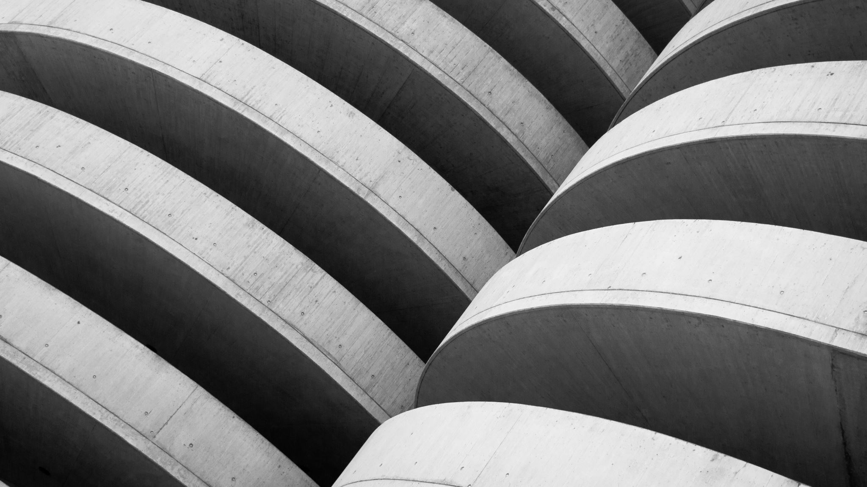
The architecture of CNN model

Slide 17
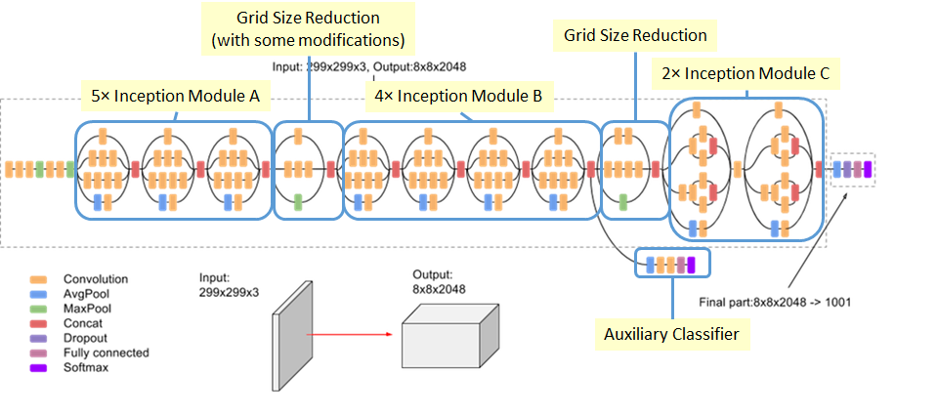
Inception V3 architecture
The main difference between the Inception models and regular CNNs are the inception blocks.
These involve convolving the same input tensor with multiple filters and concatenating their results.
Notes:
Inception v3 is a CNN for assisting in image analysis and object detection, and got its start as a module for Googlenet.

Slide 18
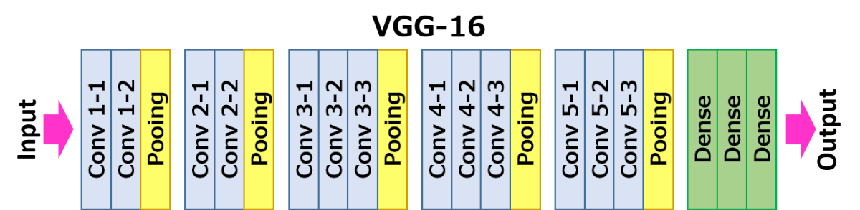
Vgg16 architecture

Slide 19
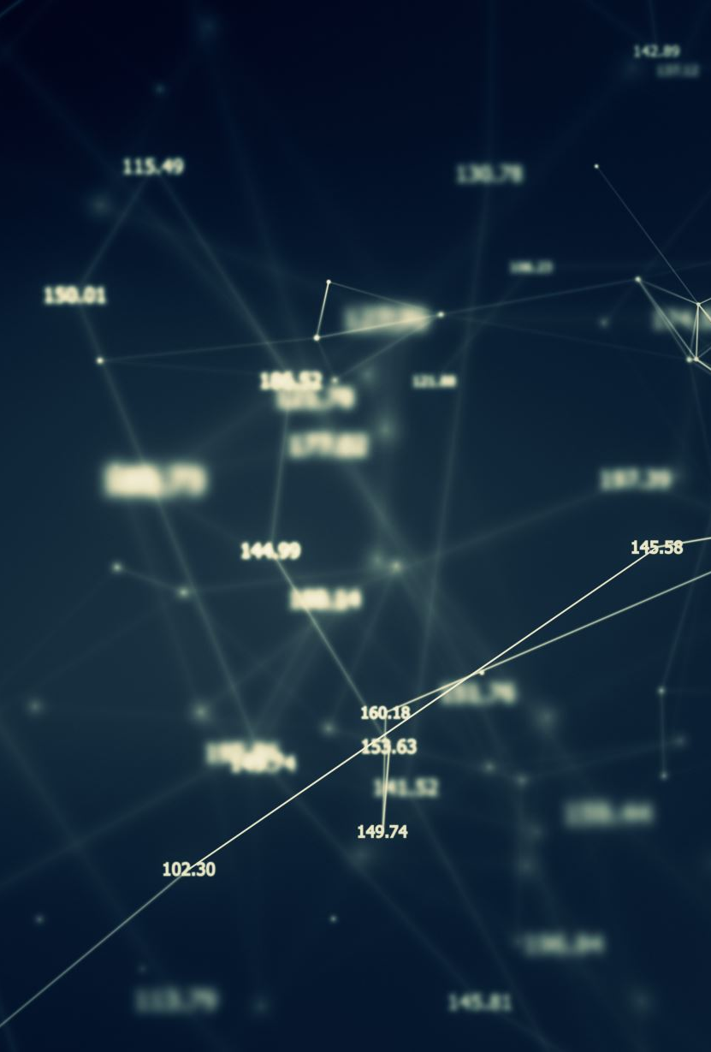
Configurations of the model
Top Layer:
Global Average Pooling layer 2D
Dense (1024, activation='relu’)
Dense (1, activation='sigmoid’)
Base_model.trainable = False
It was not necessary to perform fine tunning layers
there was no significant improvement in the results
Other parameters:
Batch size (32) and number of epochs (20 with early stopping)
Optimizer Adam, loss: binary_loss_crossentropy, metrics: accuracy
Checkpoint (early stopping)

Slide 20
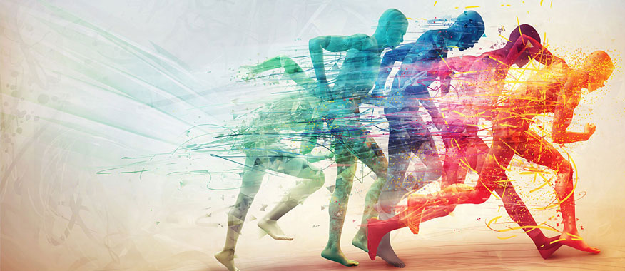
The performance

Slide 21
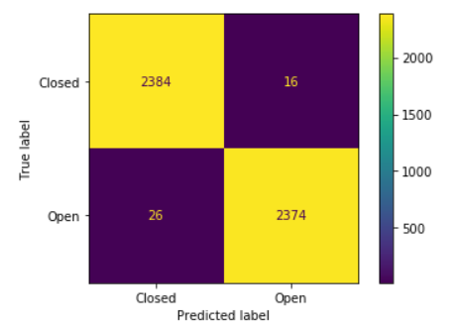
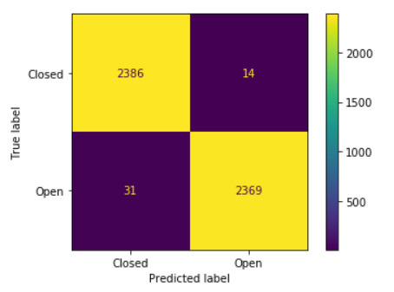
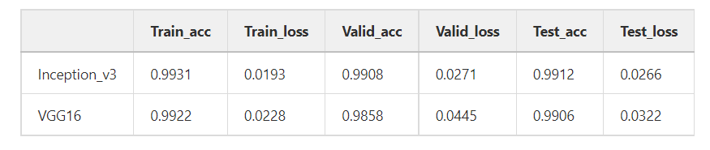
Comparisons among the models
Inception V3
VGG 16

Slide 22

The main challenges

Slide 23
Challenges
Get used to the new tools and work with heavy models
Gitlab, Clusters, Colab
Use of GPUs
Even configuring tensorflow-gpu the GPUs did not always work
Mobile
We tried to use our mobile phone camera for the demo, however, the connection speed was too slow to get a good user experience.
Eye detection
Firstly, we tried to use others face and eye detection systems, as CascadeClassifier, however then we decided to use Dlib.
We found Dlib simpler and more efficient, since it allow to identify open and closed eyes, with or without glasses, in the same model. Moreover, it is easier to identify eyes in faces of different proportions.

Slide 24
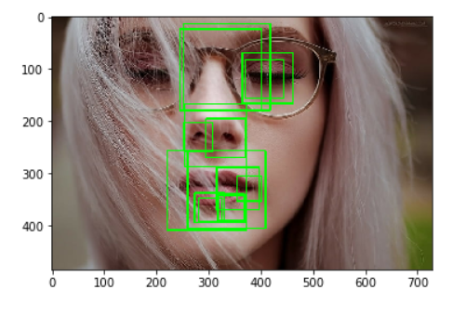
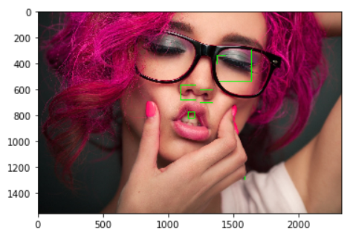

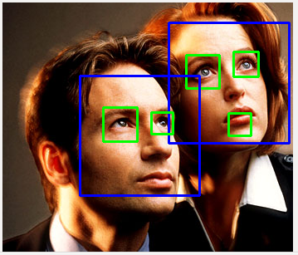
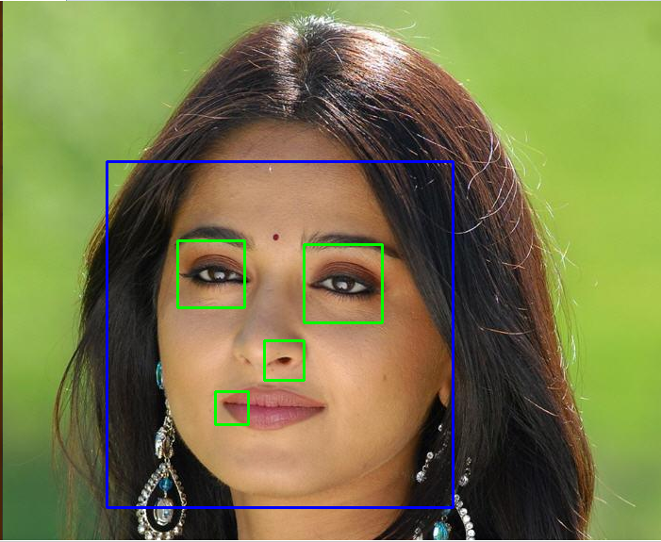
Challenges
Some examples using Cascade Classifier

Slide 25
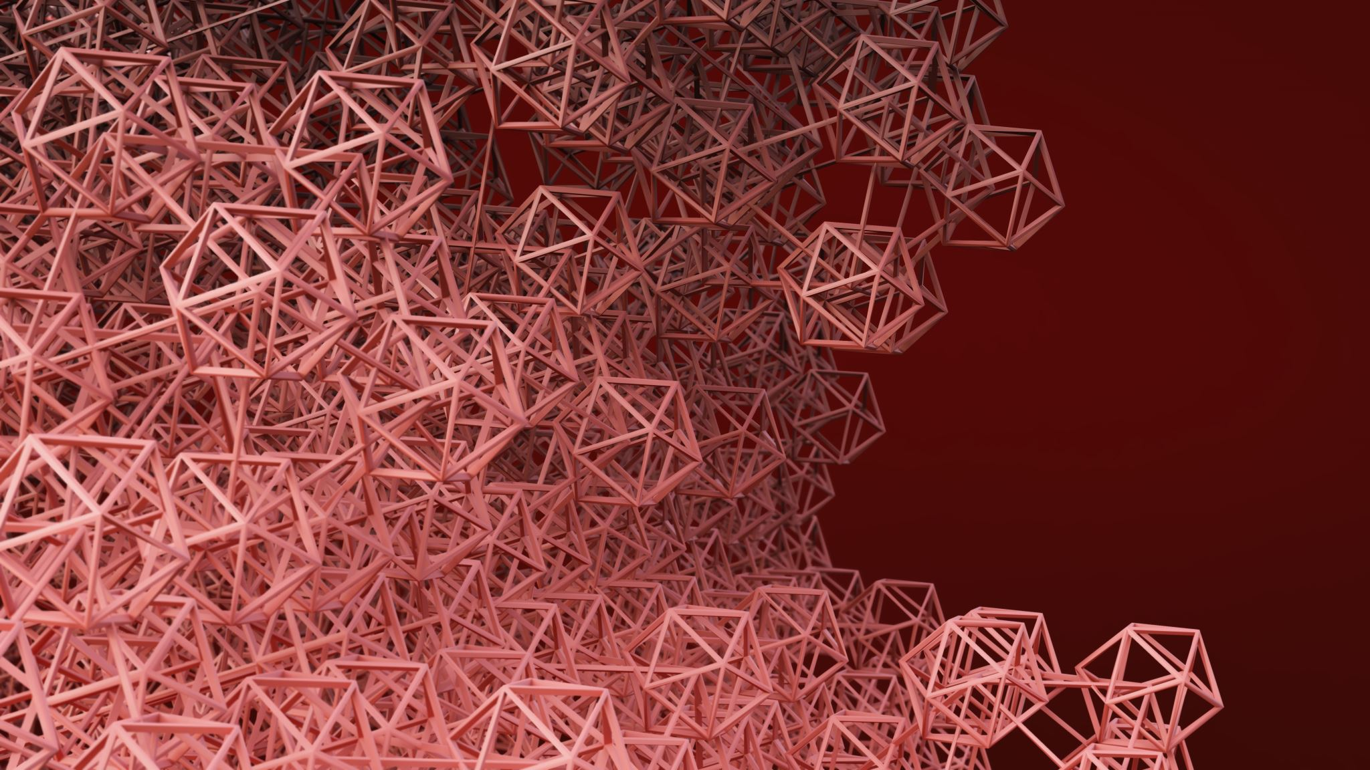
How were applied the different techniques

Slide 26

Transfer learning
Object detection
Data preprocessing and augmentation
Mini batch gradient descent

Slide 27
Lessons learned and Conclusions
Model transfer learning and object detection techniques are effective in drowsiness detection.
Create a solution that can be portable for the car, as the current solution it is only possible on the computer.
E.g. mobile app.
Significance of the models/ techniques
Limitations
Performance
Strengths
Future work
For future models
We recommend
to consider not
only closed eyes,
but also other kinds of
distractions, e.g, people
looking for a mobile,
or for another direction.
This model has a good accuracy, being effective in protecting drivers and passengers.
It is a good solution for transport companies, ubers, taxis and drivers.
Notes:
Limitations

Slide 28

Thank you. Any questions?

Slide 29

Attachments

Slide 30
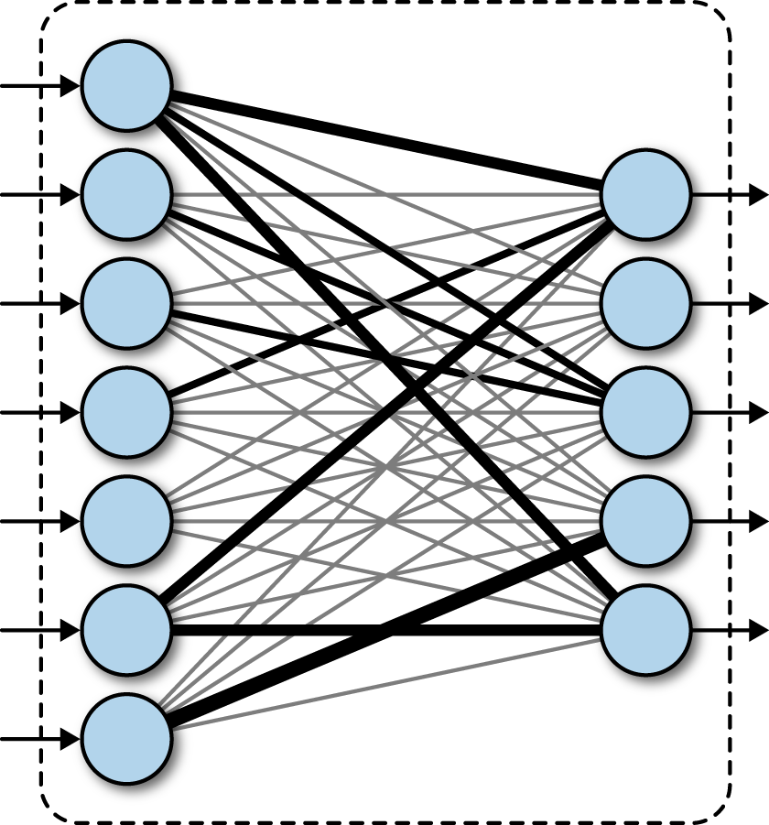
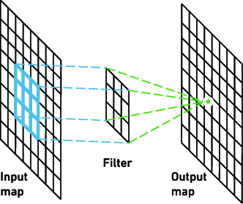

Convolutional Neural Network Architecture
A CNN typically has three layers:
Convolutional layer
1st layer - used to extract the various features from the input images.
Mathematical operation (dot product) of convolution between the input image and a filter of a particular size MxM.
Output -> Feature map which gives us information about the image such as the corners and edges.
Pooling layer
Decrease the size of the convolved feature map to reduce the computational costs. This is performed by decreasing the connections between layers and independently operates on each feature map.
e.g.: Max Pooling, Average Pooling, Sum Pooling.
The Pooling Layer usually serves as a bridge between the Convolutional Layer and the FC Layer
Fully connected layer
It is the same as a traditional multi-layer perceptron neural network (MLP). The flattened matrix goes through a fully connected layer to classify the images.
It connect every neuron in one layer to every neuron in another layer, considering the weights and biases along with the neurons.
These layers are usually placed before the output layer and form the last few layers of a CNN Architecture.
Notes:
Convolutional layer: A convolutional operation refers to extracting features from the input image and multiplying the values in the filter with the original pixel values
Pooling layer: The pooling operation reduces the dimensionality of each feature map
Fully-connected layer: The fully-connected layer is a classic multi-layer perceptrons with a softmax activation function in the output layer
In Max Pooling, the largest element is taken from feature map. Average Pooling calculates the average of the elements in a predefined sized Image section. The total sum of the elements in the predefined section is computed in Sum Pooling.

